Slide 1
Blog with API
By: Sebastian Brupbacher

Slide 2
First Step: Bootstrap
Learn the basics of Bootstrap

Slide 3
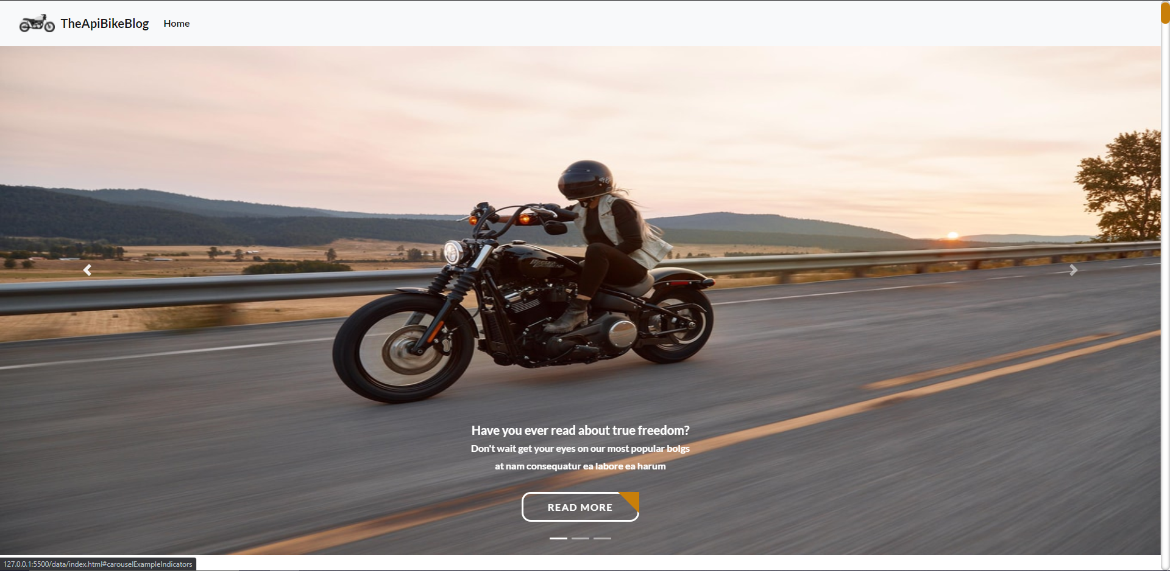
Problems?
Found myself struggling on occasions to override the preset styles with my own.

Slide 4
Second step: Fetch API and structure JavaScript functions
I structured the code in four main functions, fetching API’s to filter them and use what we were asked for.
showPost()
showModalContent()
getPostById(post_id)
getCommentsById(post_id)

Slide 5
Problems?
Once these functions were finished and working I found a problem…
When i opened the modal i saw that the titles and comments were always the first of each author.
I was not capable of finding the solution

